Slide 1
Kafka for .NET Developers
Ian Cooper
X/Hachyderm: ICooper

Slide 2
Who are you?
Software Developer for more than 25 years
Stuff I care about: Messaging, EDA, Microservices, TDD, XP, OO, RDD & DDD, Code that Fits in My Head, C#
Places I have worked: DTI, Reuters, Sungard, Beazley, Huddle, Just Eat Takeaway
No smart folks
Just the folks in this room

Slide 3
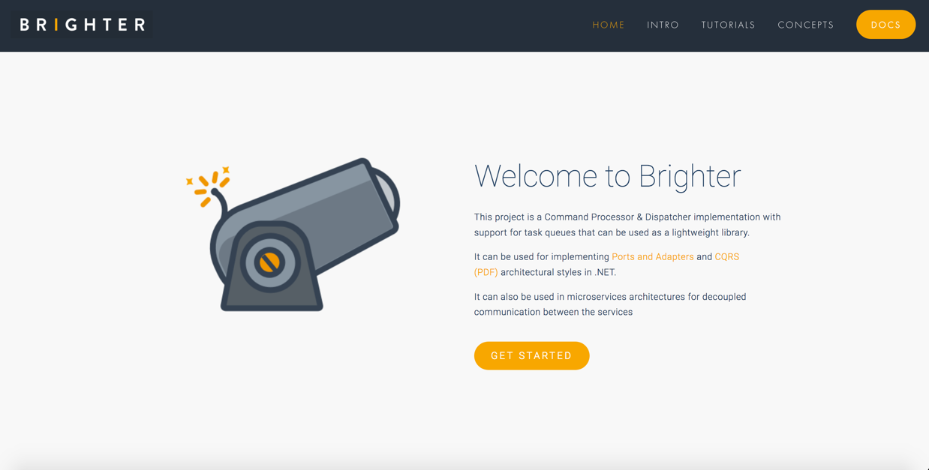

Slide 4
Links
The Sample Code: https://github.com/iancooper/KafkaForDotNetDevs
Brighter: https://github.com/BrighterCommand/Brighter
This Presentation: https://github.com/iancooper/Presentations

Slide 5
Agenda
Kafka
Managing Kafka
Kafka and C#
Under the Hood
Reliable Producer
Reliable Consumer
Serializers, De-serializers & Schema Registry
Brighter
9. Q&A

Slide 6
Kafka
3

Slide 7
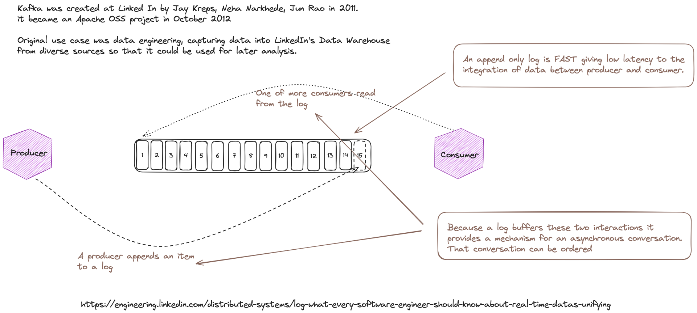
Notes:
A buffer – the log – between producer and consumer – allows Kafka to support an asynchronous conversation (both parties do not need to be present due to store and forward) i.e. messaging

Slide 8
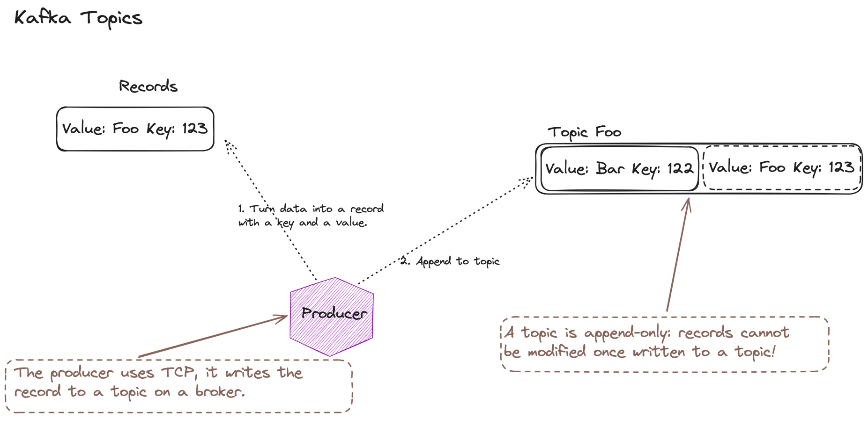
Notes:
The topic is what messaging calls a “channel” a virtual pipe, addressable by a name. Both sides need to agree the channel name.

Slide 9
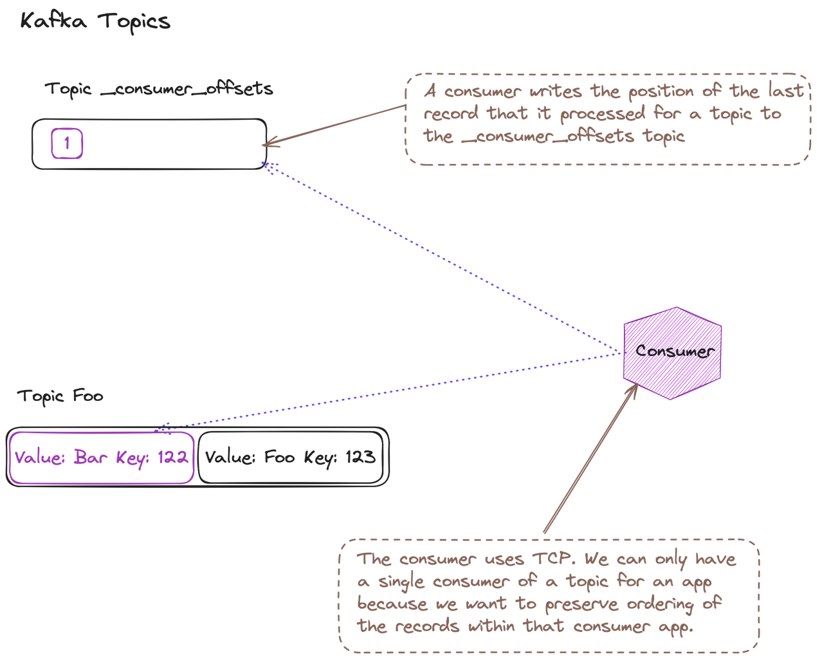
Notes:
A consumer’s read is non-destructive, unlike a queueing system, we don’t delete the item, we simply move our index for what we have seen. This means many consumers can read the same topic, maintaining their own offset into what they have read.
Given that a consumer maintains it’s own index, then how do we read a topic faster? If we simply add more consumers, each new consumer will start reading at the beginning of the topic. If we have consumers share the same offset then they will loose ordering

Slide 10
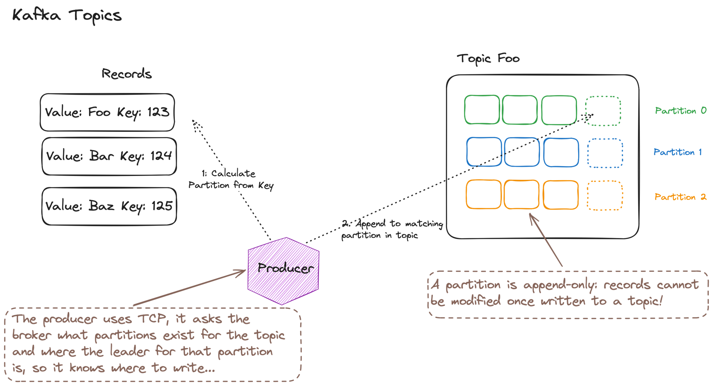
Notes:
To scale we need to partition the topic, so that consumers can read a partition on the topic instead of the topic. When a producer writes it writes to the leader for a partition. The partition is determined by an algorithm. We could just randomly assign, to balance across our partitions, but if we want to support reading all of the data for a particular key in order, such as subsequent changes to an order, or customer record, we need anything with the same key to go to the same partition, for this we commonly use consistent hashing

Slide 11
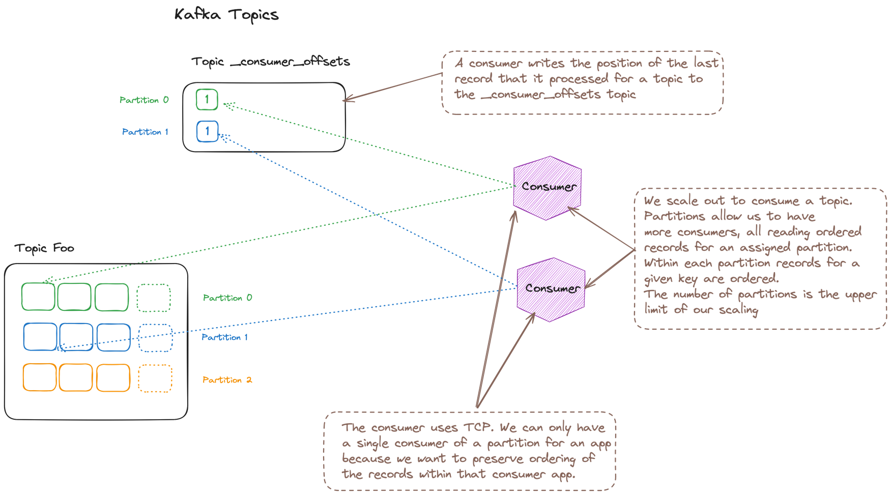
Notes:
A consumer reads from a partition, and records offsets into that partition. This allows us to scale out, we can usefully have as many consumers as partitions.
How do you know how many partitions you want? Queueing theory. In essence rate of consumption must exceed rate of arrival to avoid a queue backing up. If it takes Xms to process and work arrives every Yms then Y/X >= 1

Slide 12
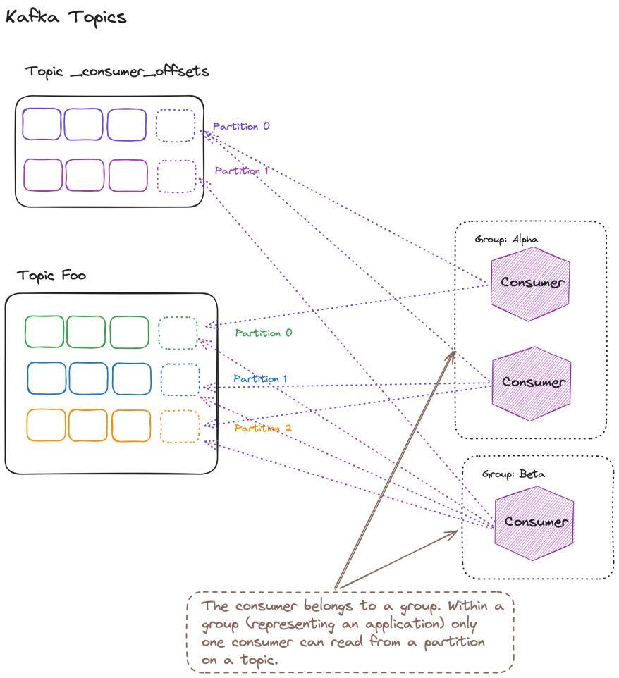
Notes:
Now a given application wants to read all of a topic, regardless of how many consumers are running. Kafka supports the notion of a consumer group, which allow you to ensure that all the partitions for a topic will be read, with each partition being assigned at most one reader (so as to preserve ordering); a consumer may be assigned multiple partitions if there are more partitions than consumers (this may be useful if you want to scale down outside of peak).

Slide 13
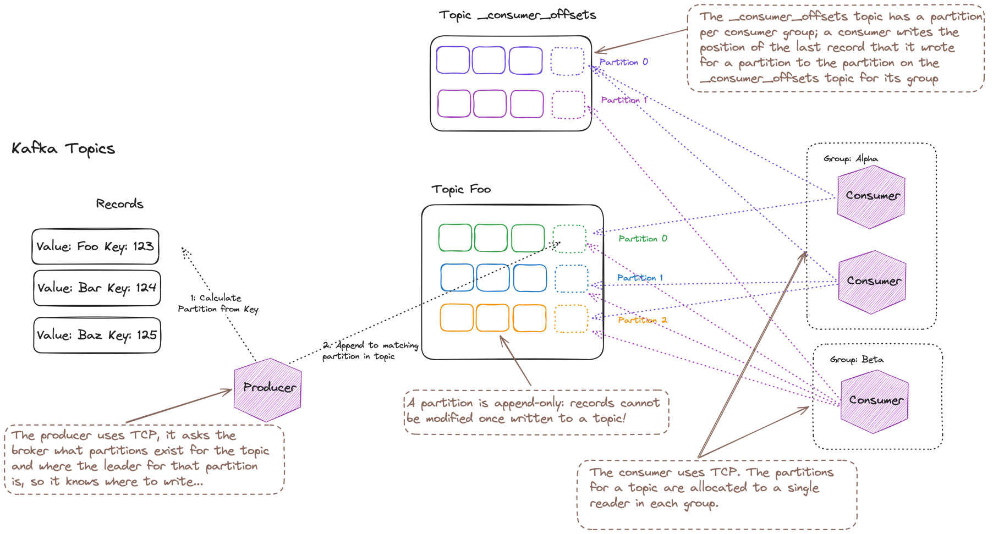
Notes:
An overall picture of how Kafka works

Slide 14
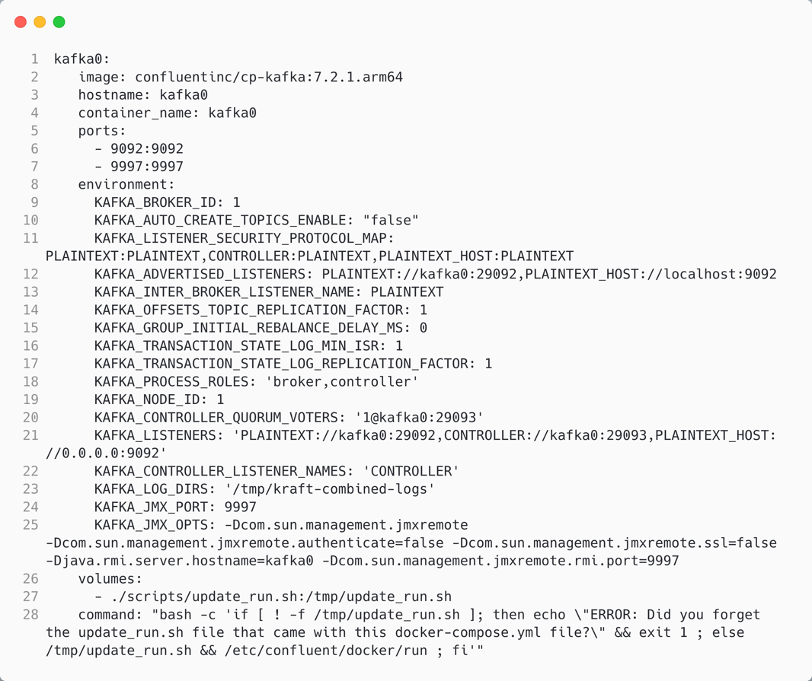
Running Kafka
If a topic does not exist when a producer writes, what should Kafka do?
The advertised listeners are the endpoints that clients should use to communicate with broker
The roles that this node plays
The listeners are the endpoints that the broker listens on
We need to run a script to run without zookeeper

Slide 15
Managing Kafka
3

Slide 16
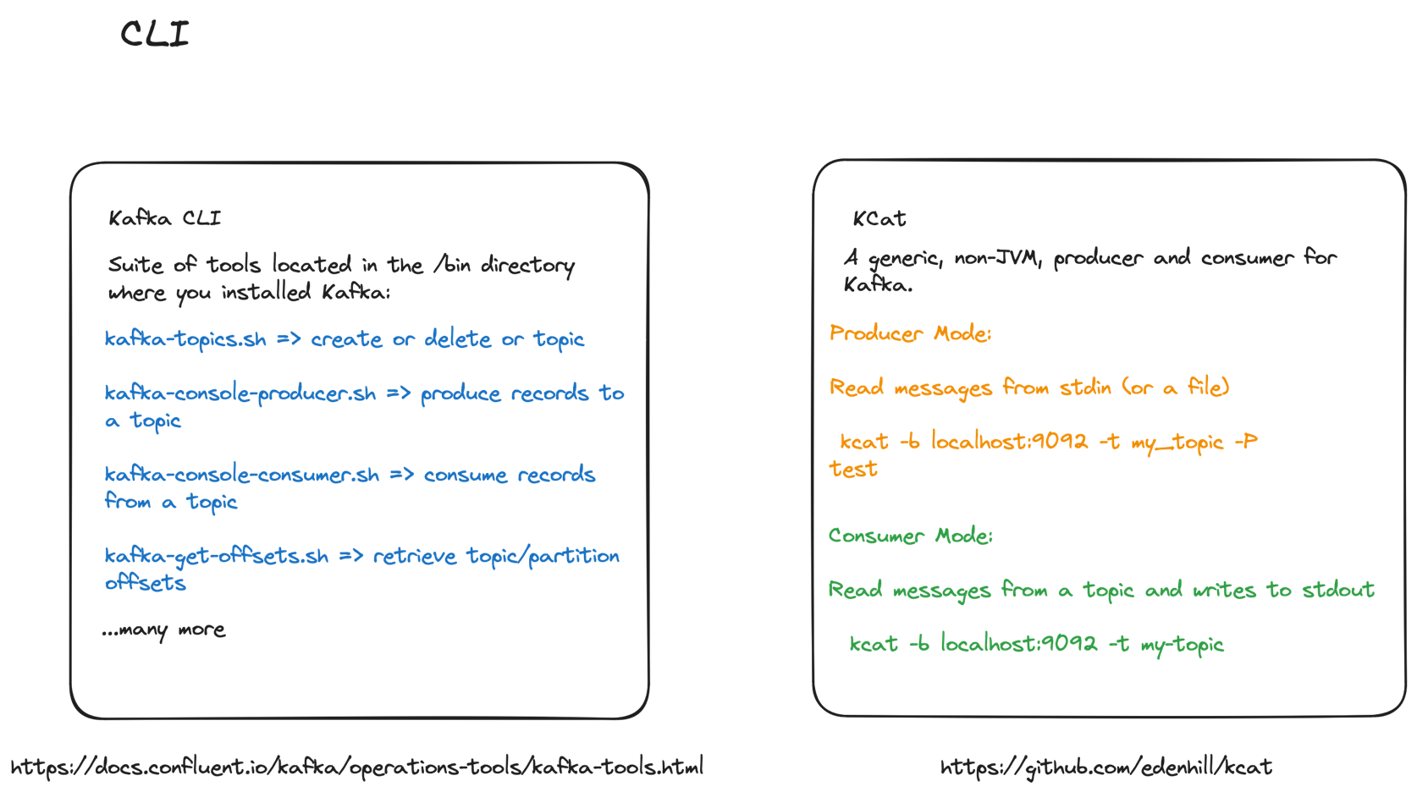

Slide 17
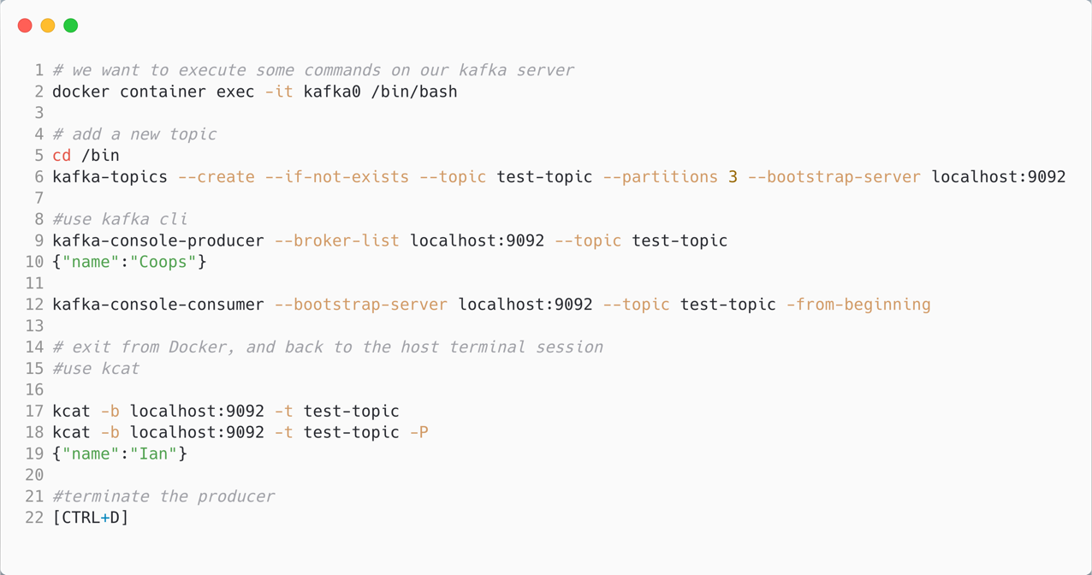
Demo One: CLI Tools

Slide 18
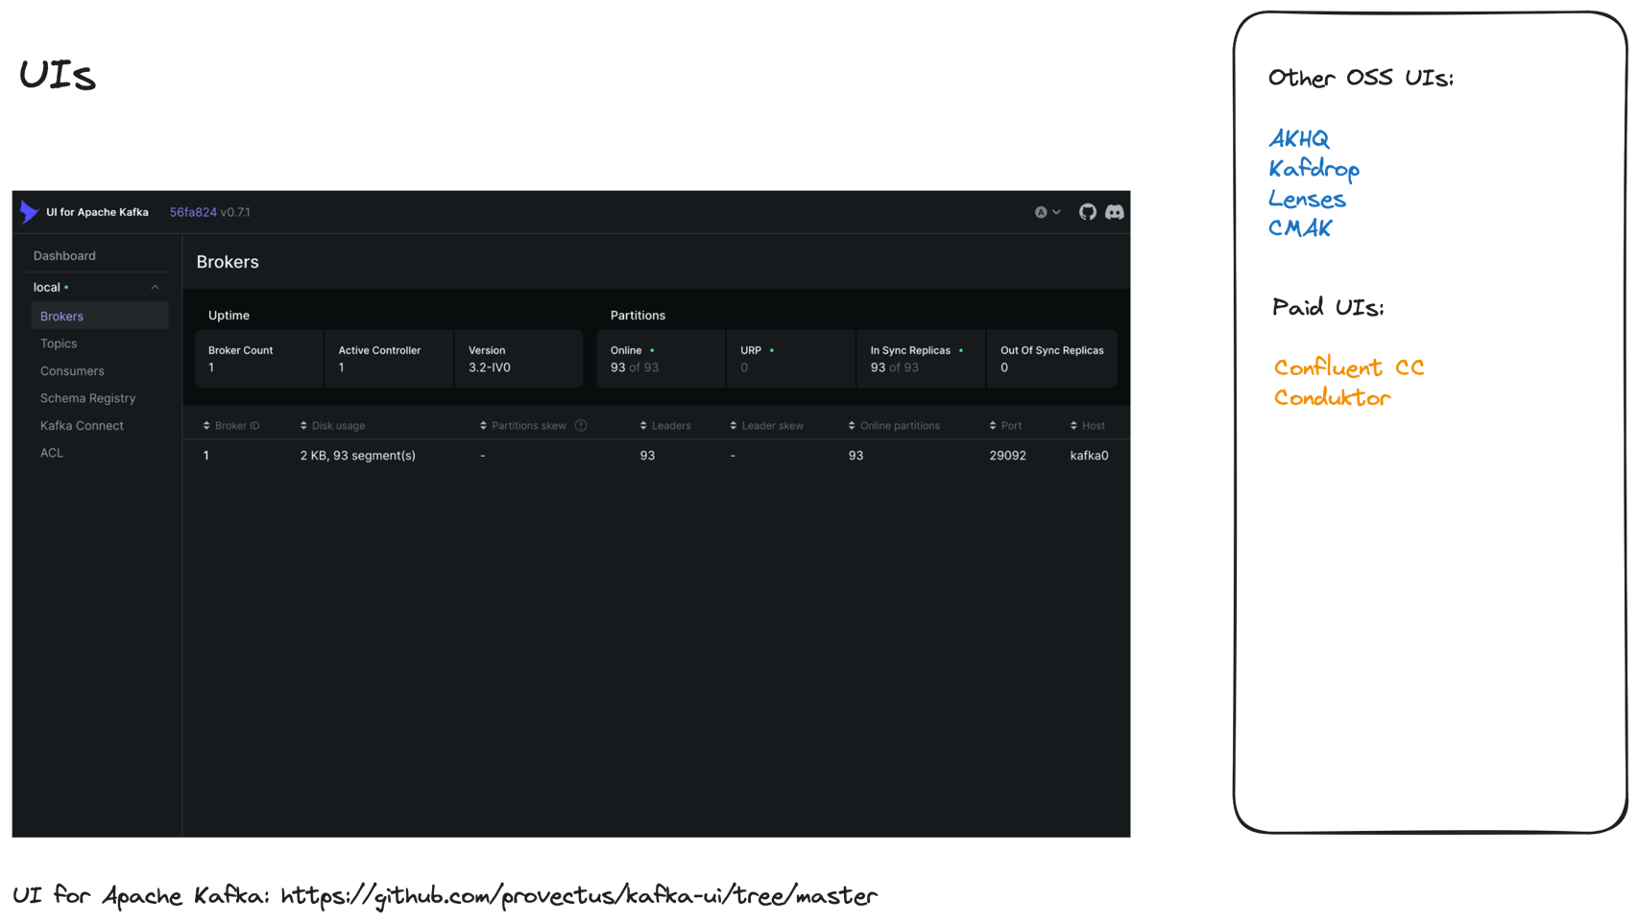

Slide 19
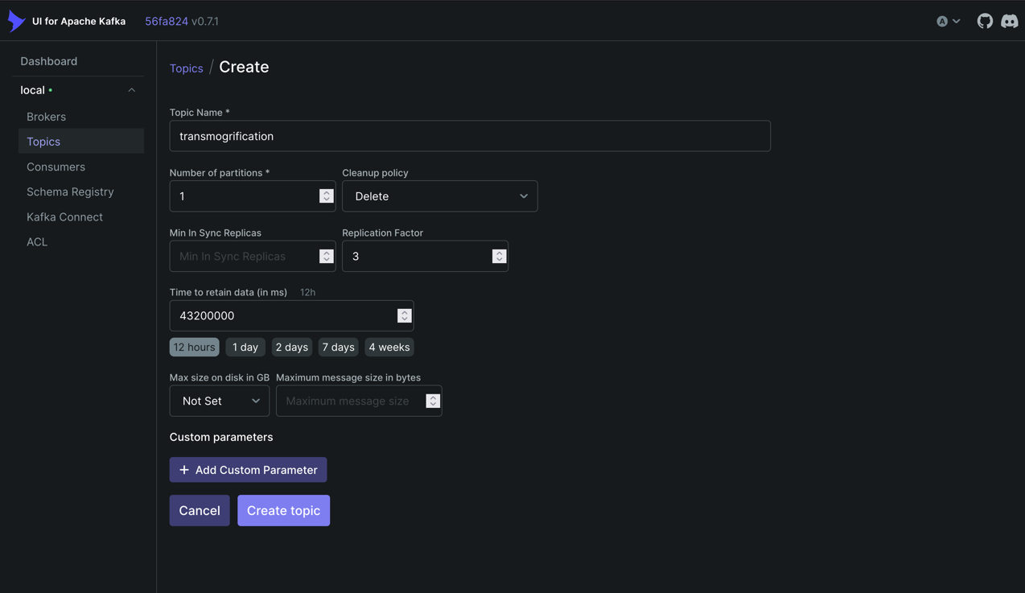
Demo: UI Tools

Slide 20
Kafka and C#
3

Slide 21
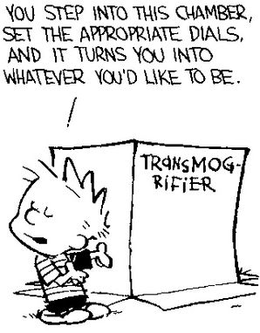
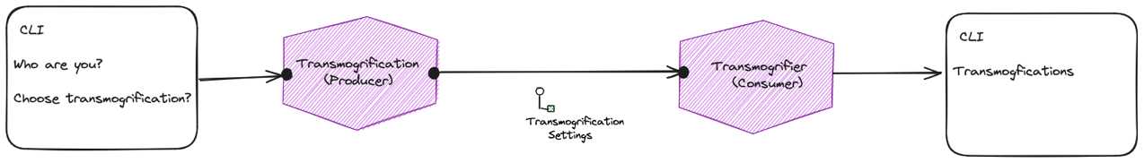
Building a Transmogrifier
Calvin and Hobbes – Bill Watterson

Slide 22
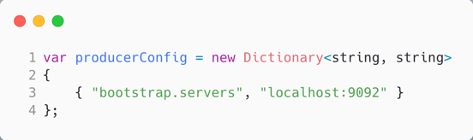
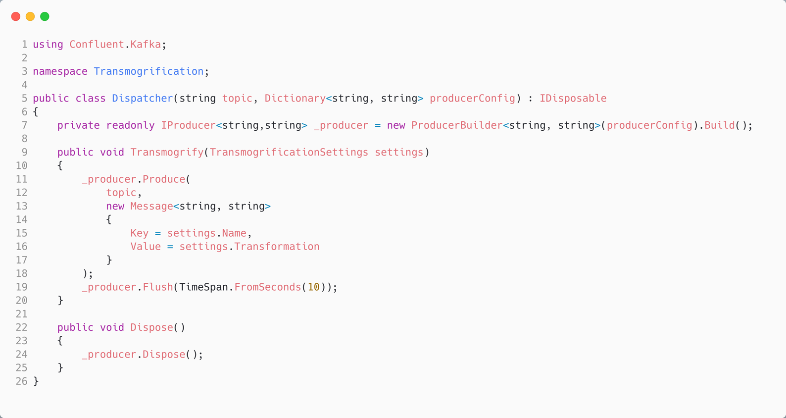
Producing a Message in C#
The topic we want to produce to.
Create a producer from the config; note that ProducerBuilder<string, string> means:
- key: string
- value: string
Tidy.
Produce a message to a topic; build message from our data
Notes:
Note ProducerBuilder<string, string> and MessageBuilder<string, string>. Note that later we will use type safety. Might be interesting to note that Brighter uses <string, byte[]> as we always serialize the body as a byte[]

Slide 23
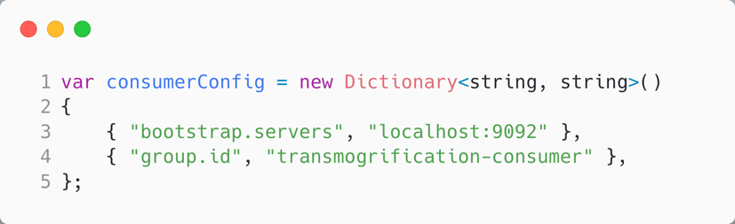
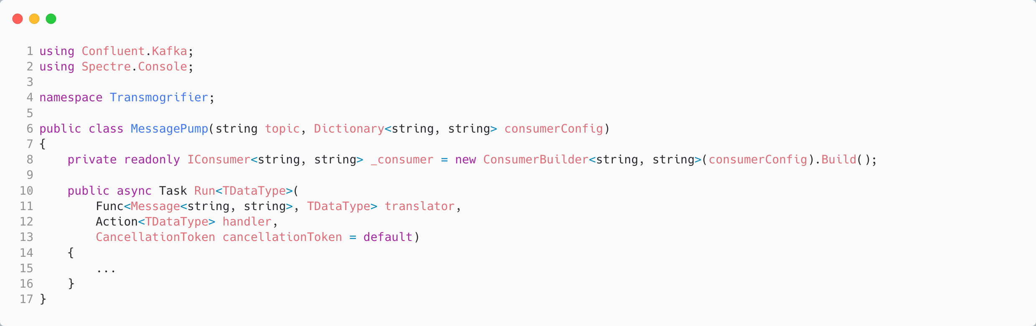
Consuming a Message in C#
The topic we want to consume from.
Create a consumer from the config; note that IConsumer<string, string> means:
- key: string
- value: string
Generic, so pass in:
- translator
- handler

Slide 24
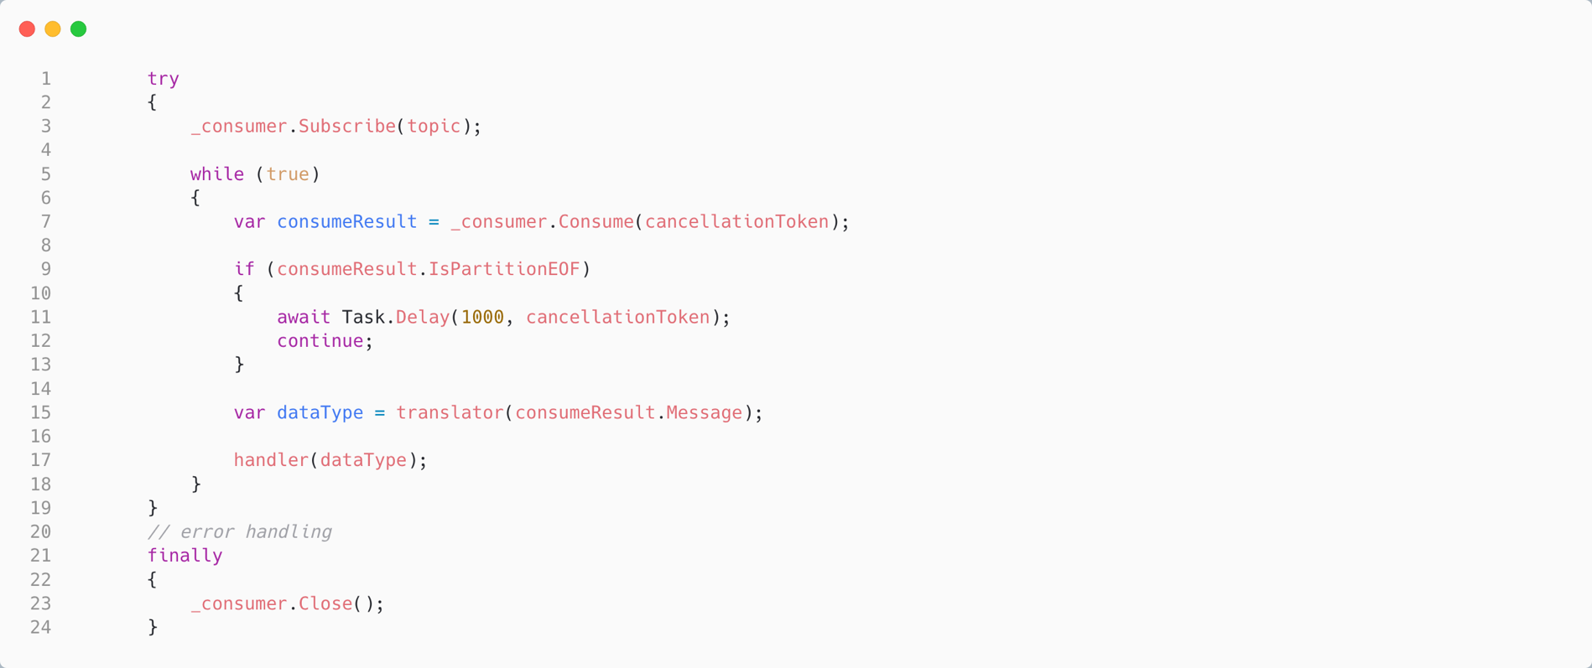
Consuming a Message in C#
Subscribe to topic
Message Pump is an endless loop
Read next result; SDK is buffering for us. Yield if nothing in buffer. Break if cancelled.
Translate the message
Handle the message
Tidy

Slide 25

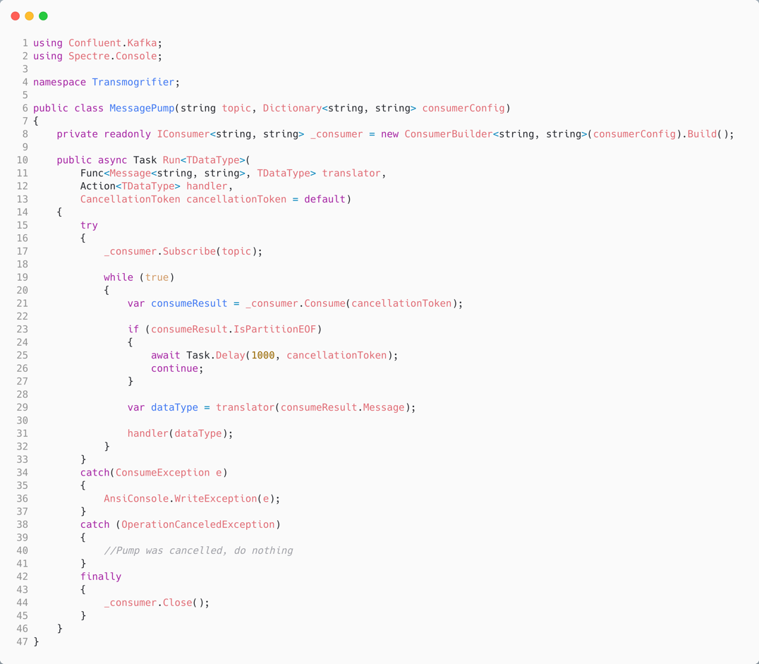
Consuming a Message in C#
The topic we want to consume from.
Generic, so pass in:
- translator
- handler
Subscribe to topic
Create a consumer from the config; note that IConsumer<string, string> means:
- key: string
- value: string
Message Pump is an endless loop
Read next result; SDK is buffering for us. Yield if nothing in buffer. Break if cancelled.
Translate the message
Handle the message
Tidy

Slide 26
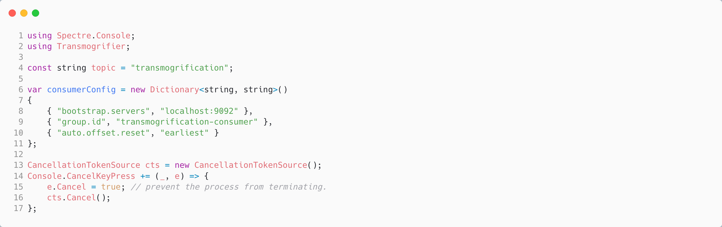
Using the C# Consumer
The topic we want to consume from.
Configure:
- where is Kafka?
- what is our group?

Slide 27
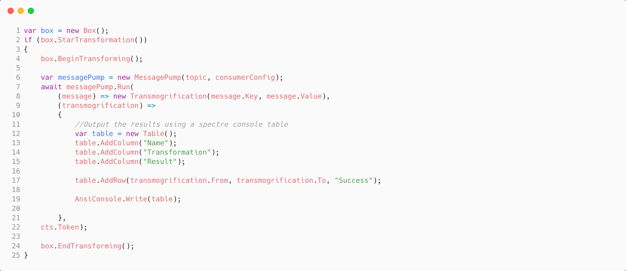
Using the C# Consumer
Translate the message to a data type
Handle the message

Slide 28
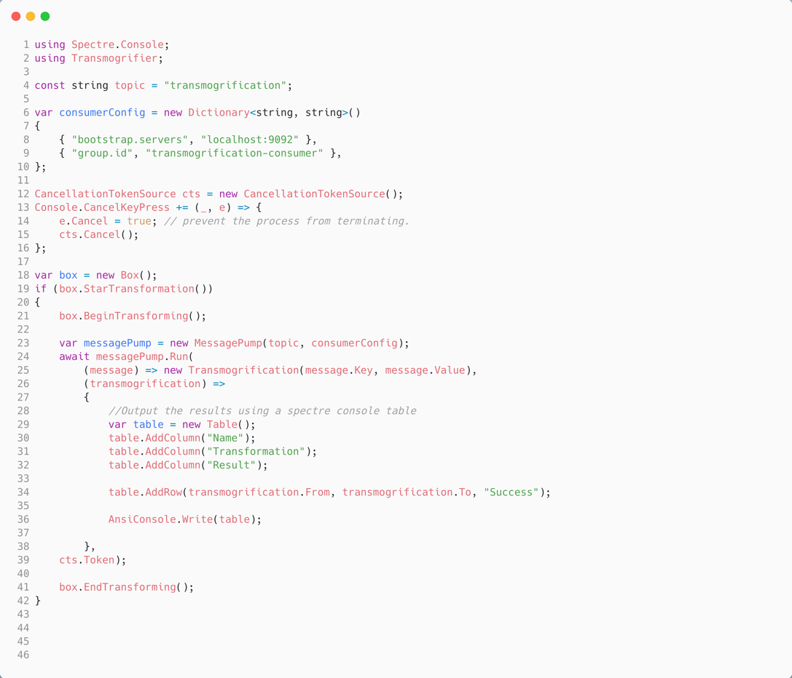
Using the C# Consumer
The topic we want to consume from.
Configure:
- where is Kafka?
- what is our group?
Translate the message to a data type
Handle the data type

Slide 29


Demo Two: Produce and Consume A Message
Calvin and Hobbes – Bill Watterson

Slide 30
Under the Hood
30

Slide 31
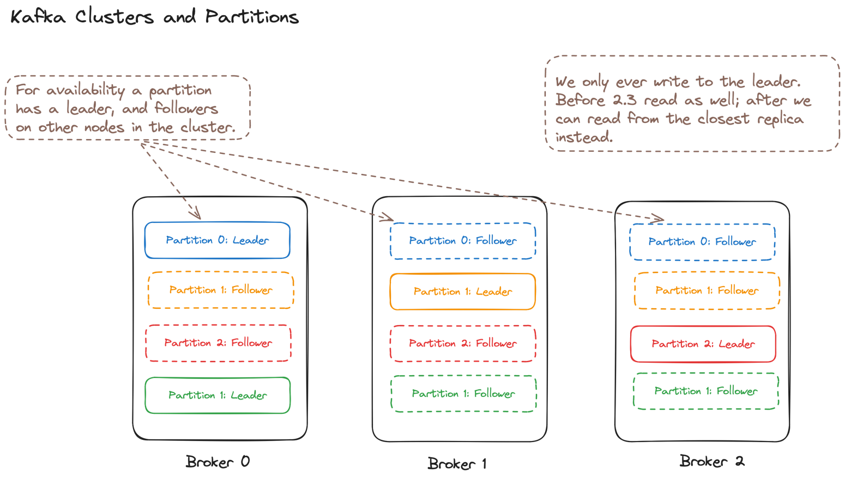

Slide 32
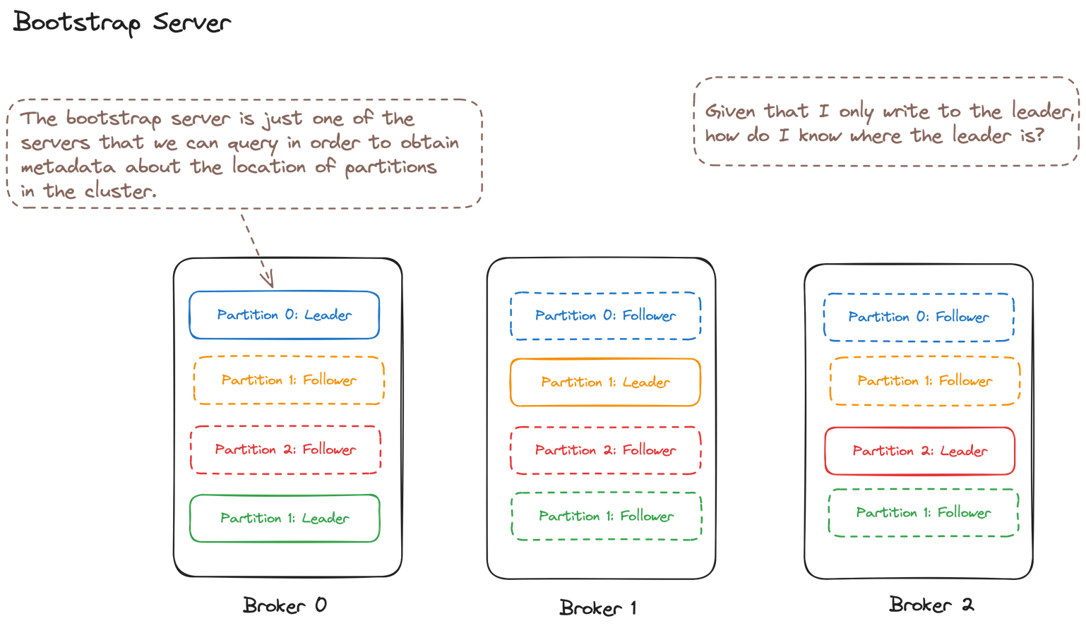

Slide 33
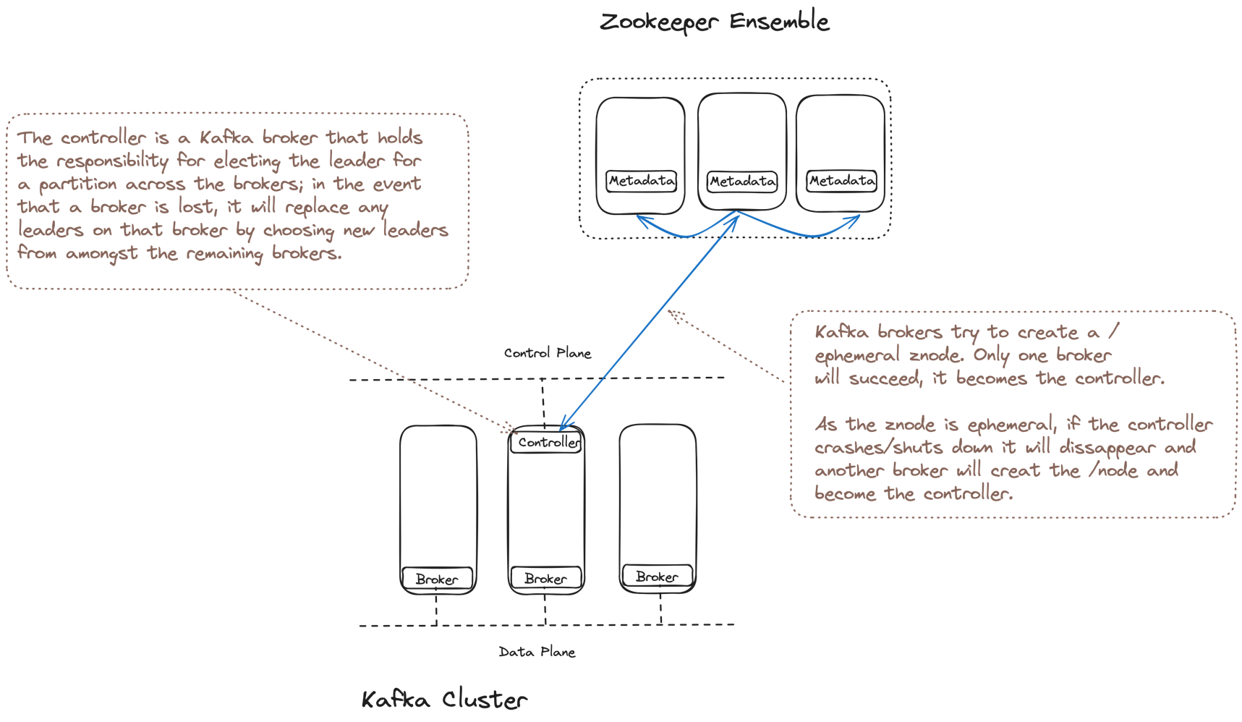

Slide 34
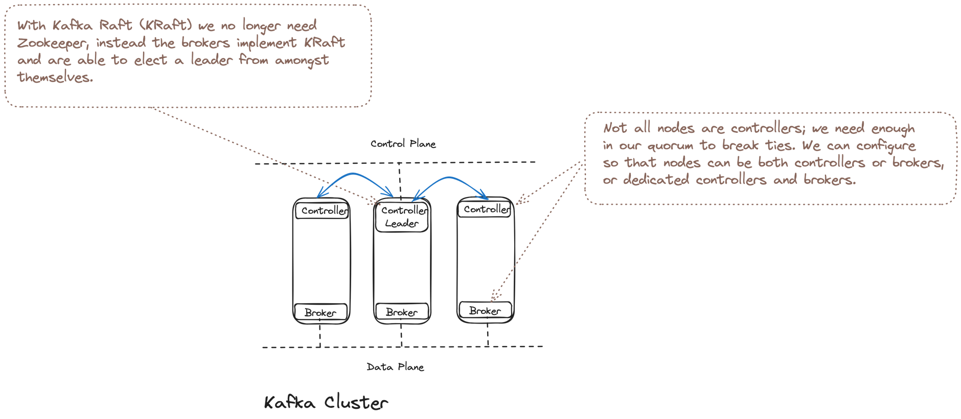

Slide 35
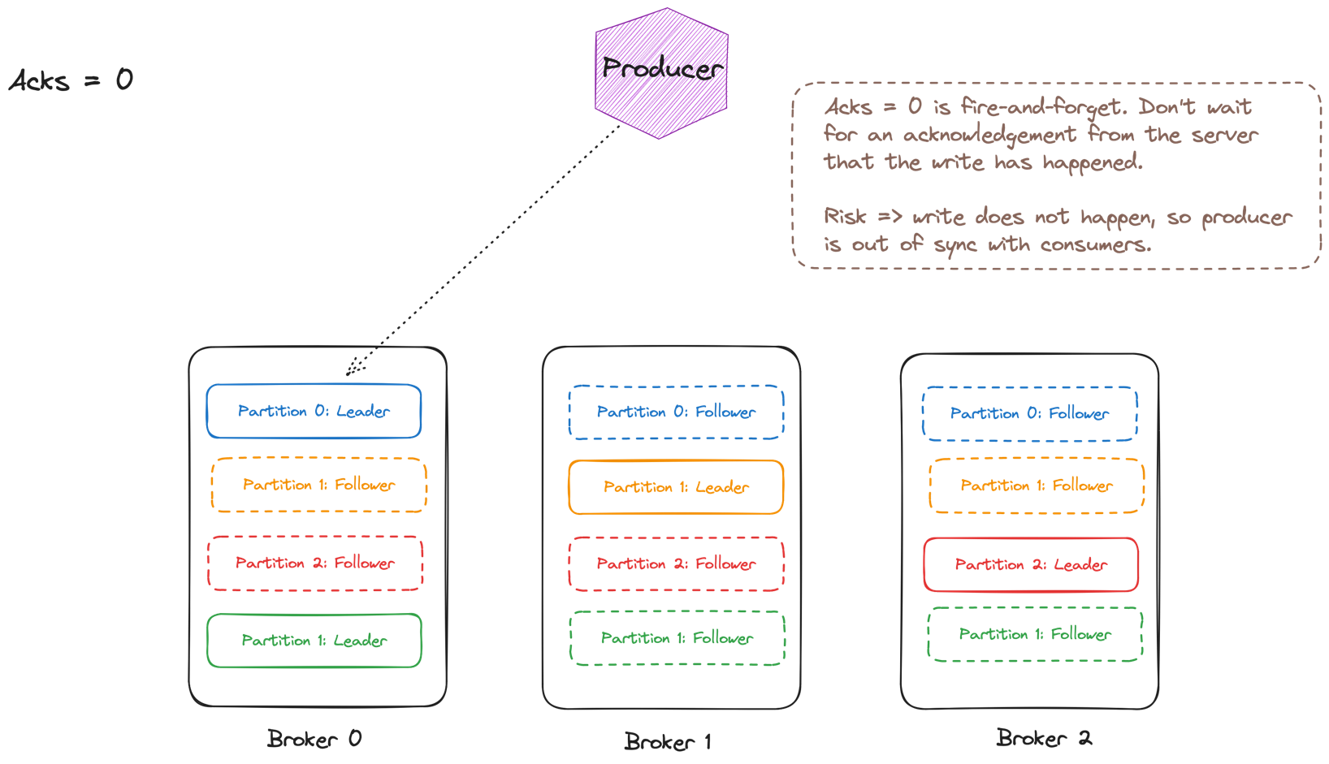

Slide 36
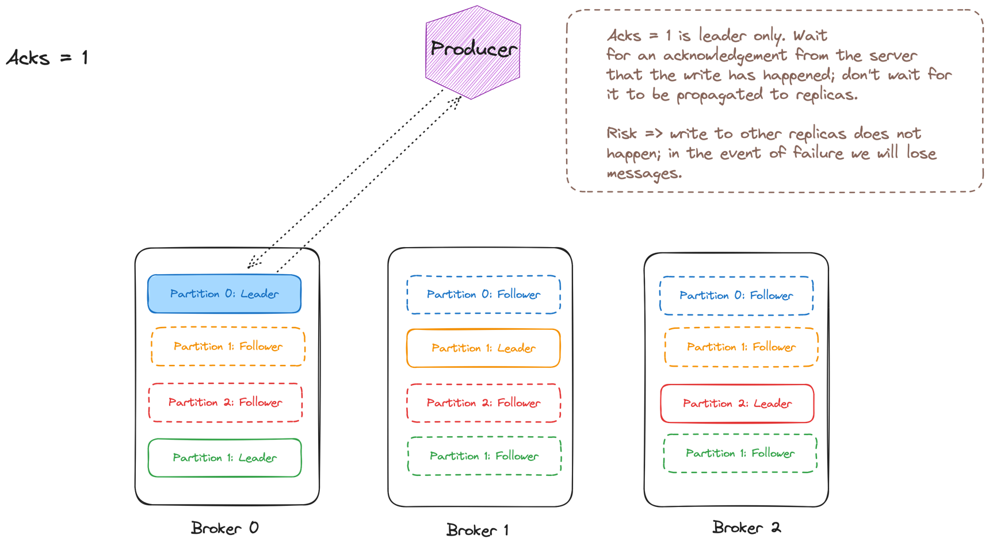

Slide 37
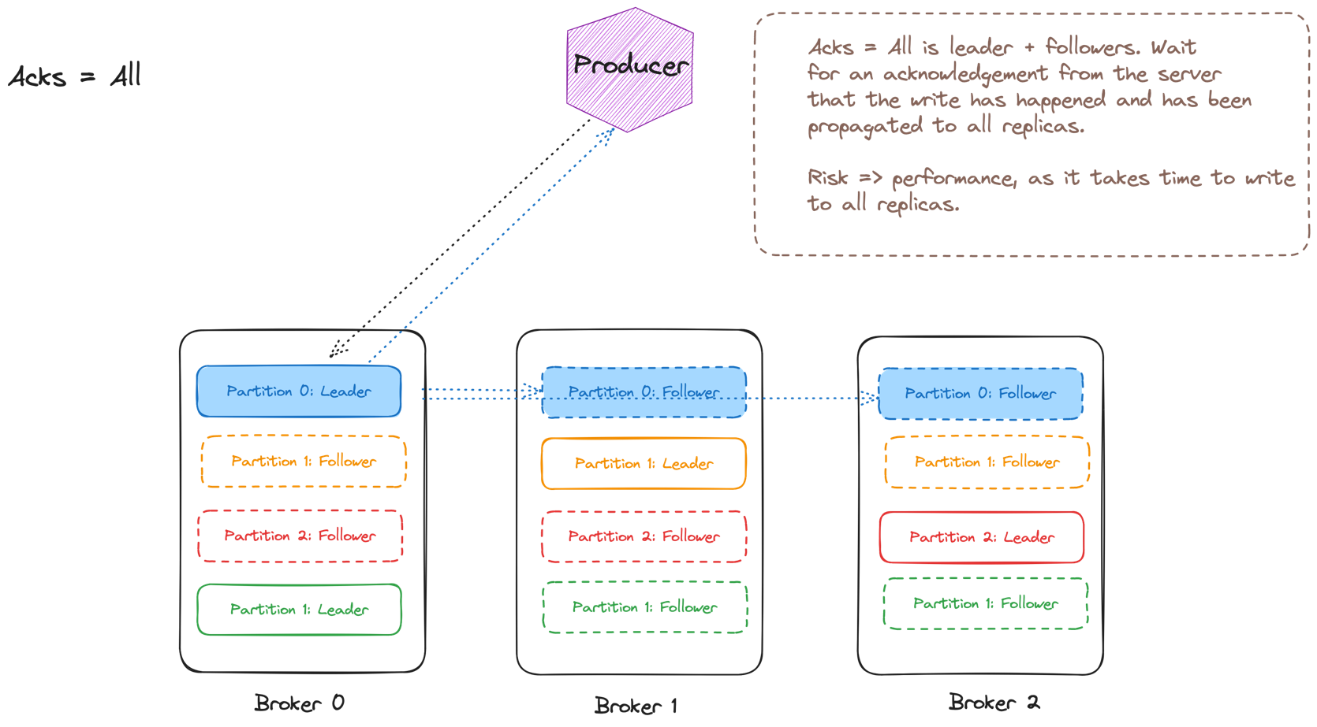

Slide 38
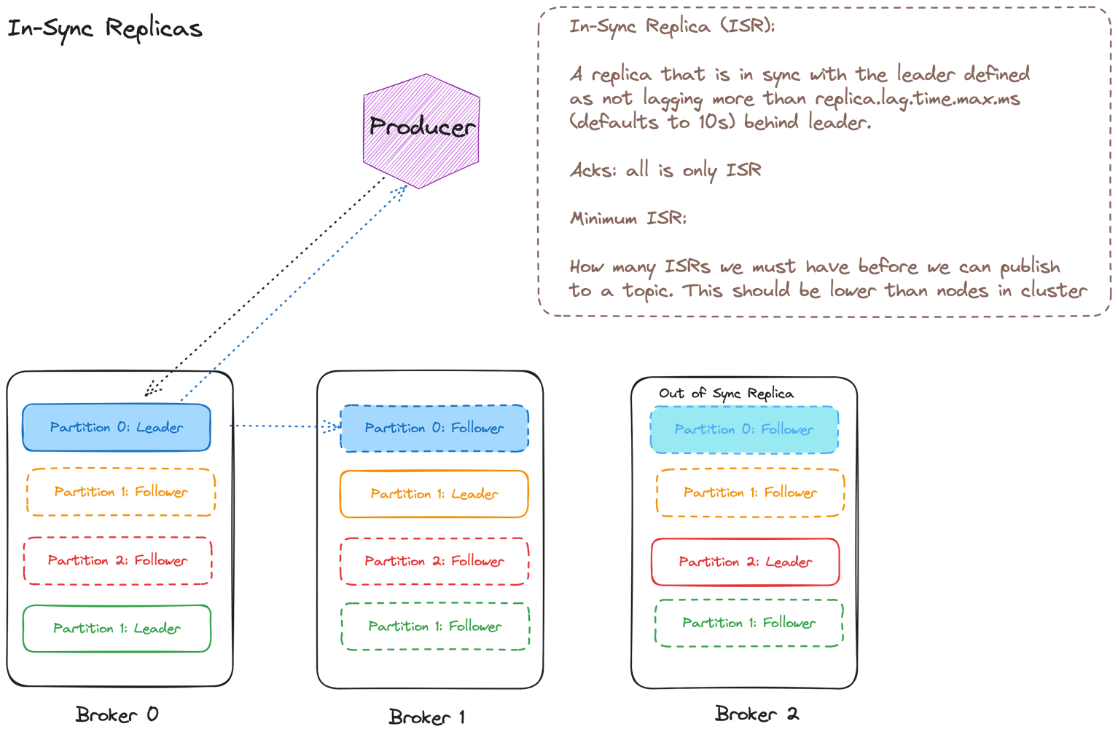

Slide 39
Reliable Producers
30

Slide 40
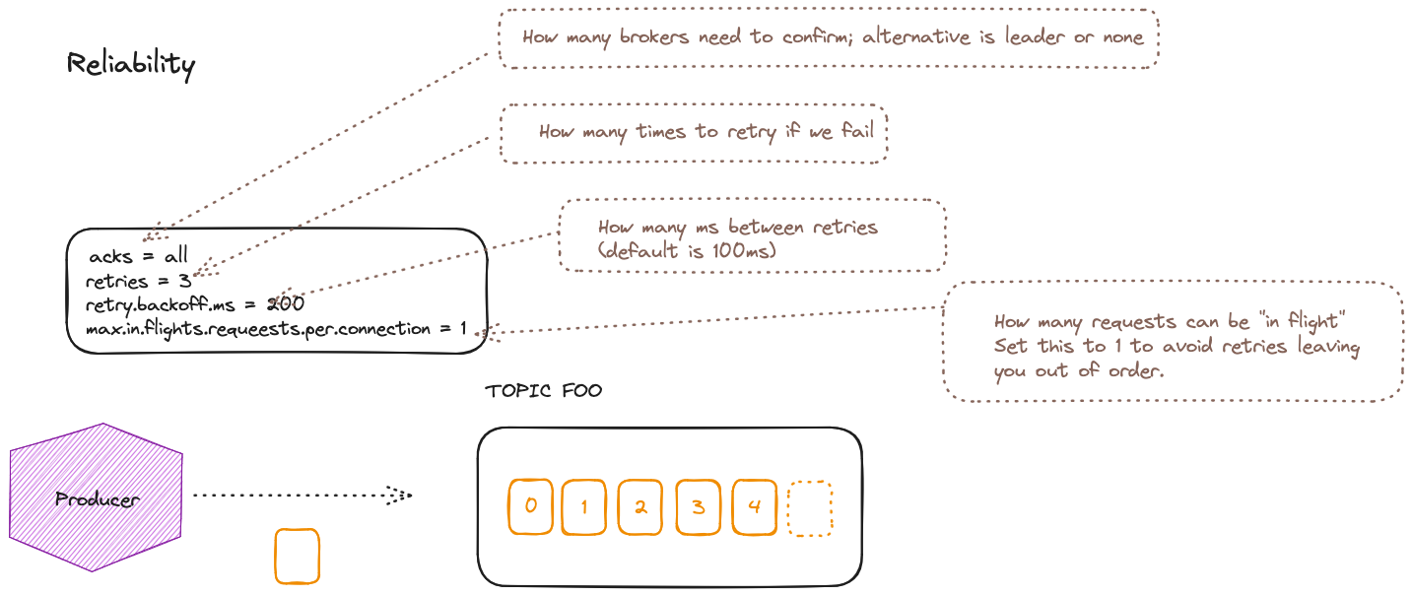

Slide 41
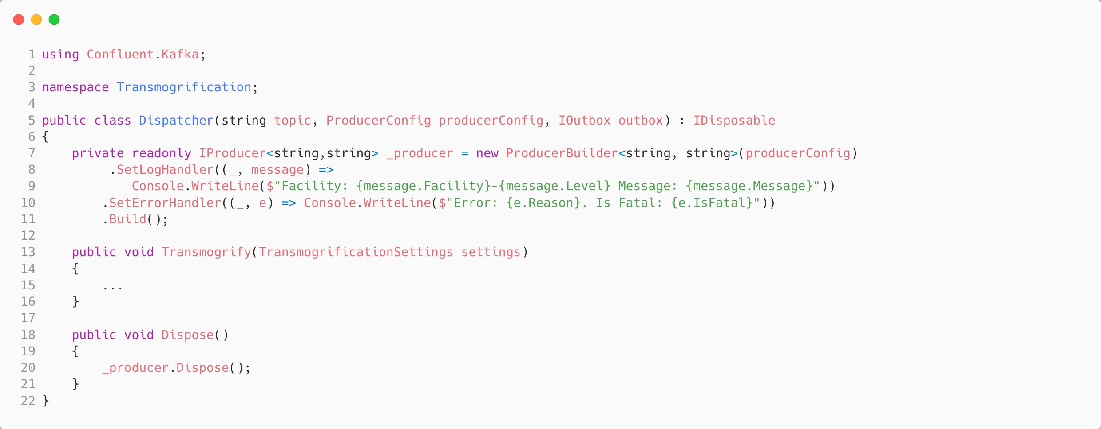
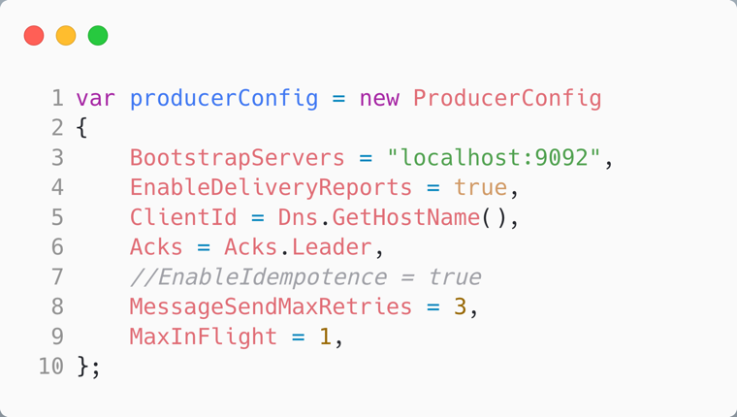
Reliably Producing a Message in C#
Configure how the SDK gives us feedback on producing messages
Notes:
//we use an outbox to be able to retry sending the message if it fails we don't show a sweeper in this example, but it would be a separate process that would periodically check the outbox for messages that haven't been persisted yet and retry sending them

Slide 42
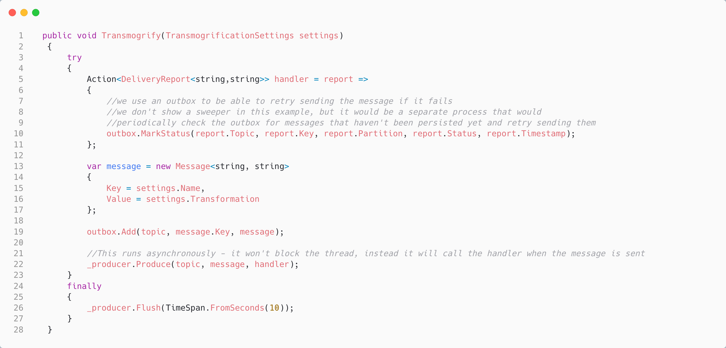
Reliably Producing a Message in C#
Mark the outbox with the status of the produce on callback
Use an “outbox” for “Transactional Messaging” [Simplified]
Don’t block on ack, instead set a callback to assess the delivery report
Notes:
//we use an outbox to be able to retry sending the message if it fails we don't show a sweeper in this example, but it would be a separate process that would periodically check the outbox for messages that haven't been persisted yet and retry sending them

Slide 43
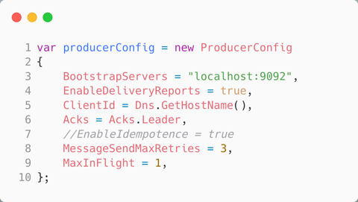
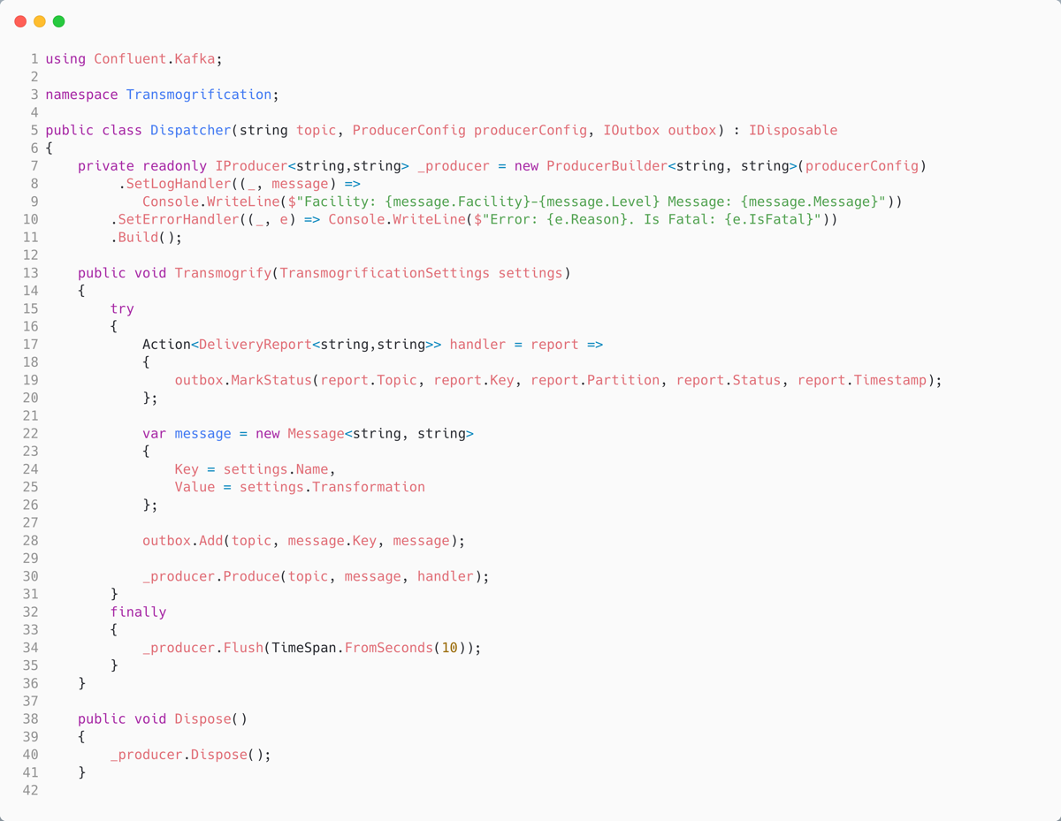
Reliably Producing a Message in C#
Configure how the SDK gives us feedback on producing messages
Mark the outbox with the status of the produce on callback
Use an outbox for Transactional Messaging
Don’t block on ack, instead set a callback to assess the delivery report
Notes:
//we use an outbox to be able to retry sending the message if it fails we don't show a sweeper in this example, but it would be a separate process that would periodically check the outbox for messages that haven't been persisted yet and retry sending them

Slide 44
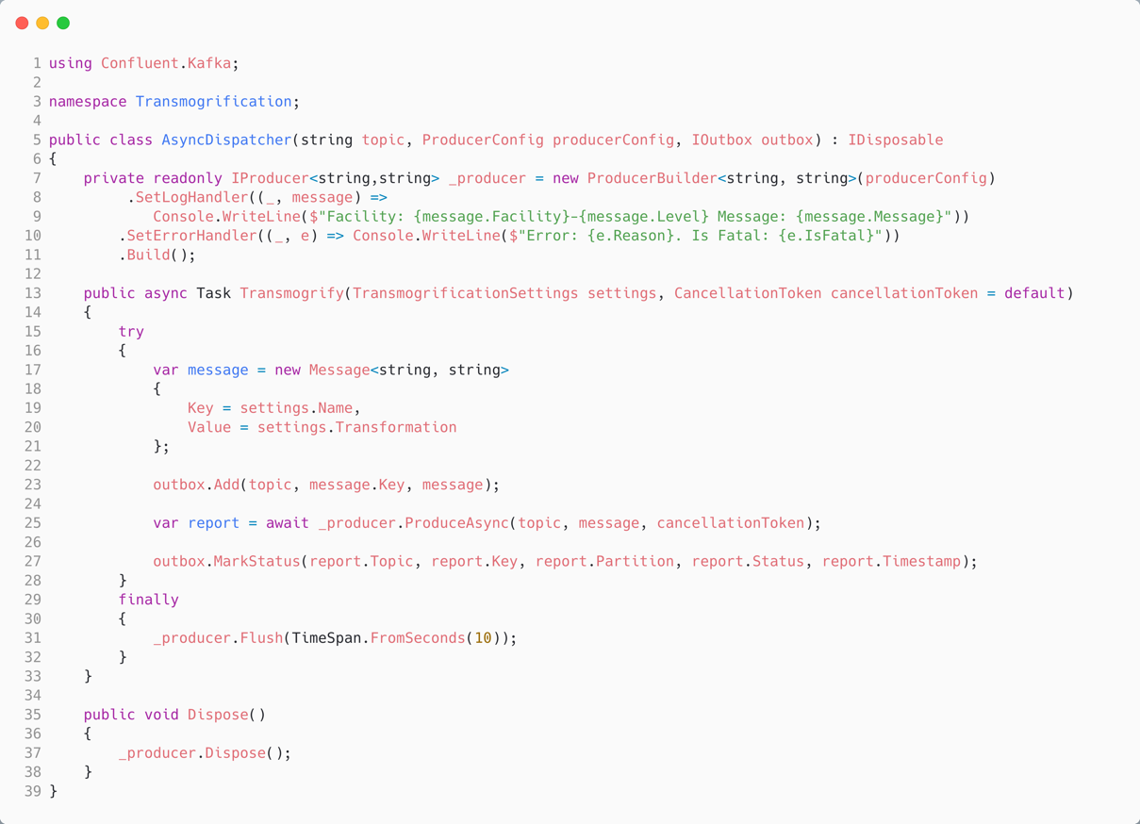
Async Reliably Producing a Message in C#
Instead of a callback using async/await for the delivery report – will not return until deliveryreport is produced, which depends on acks.
In principle, at scale, the throughput of async/await will be lower than using Produce with a callback

Slide 45

Demo Three: Reliable Producer
Calvin and Hobbes – Bill Watterson

Slide 46
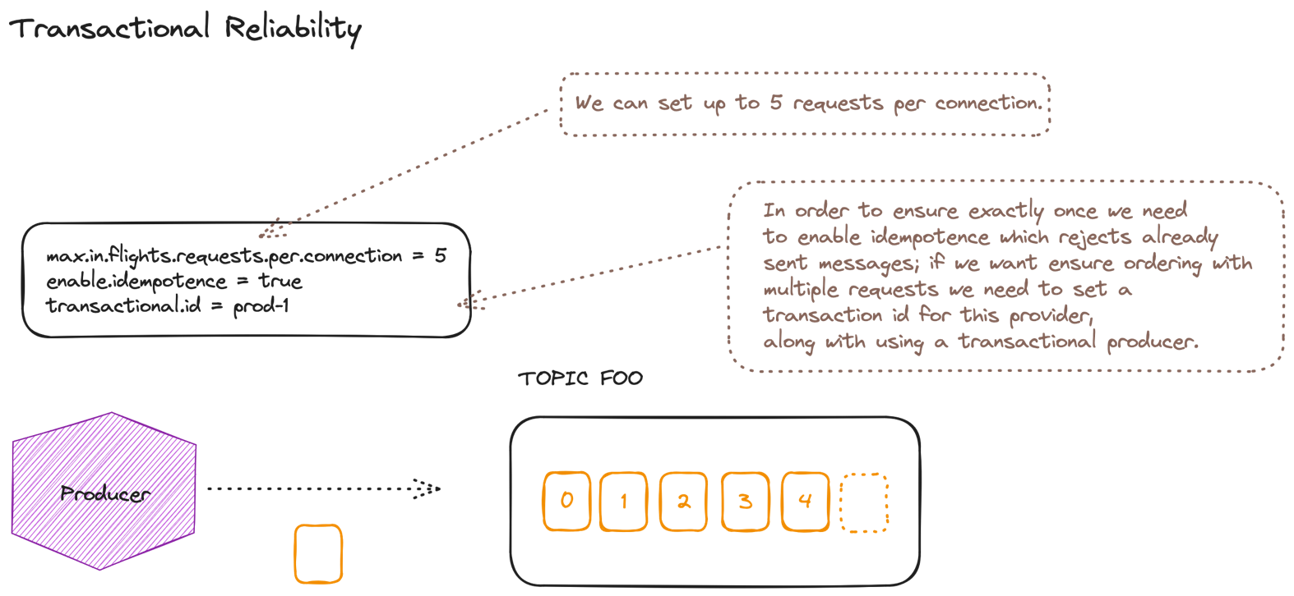

Slide 47
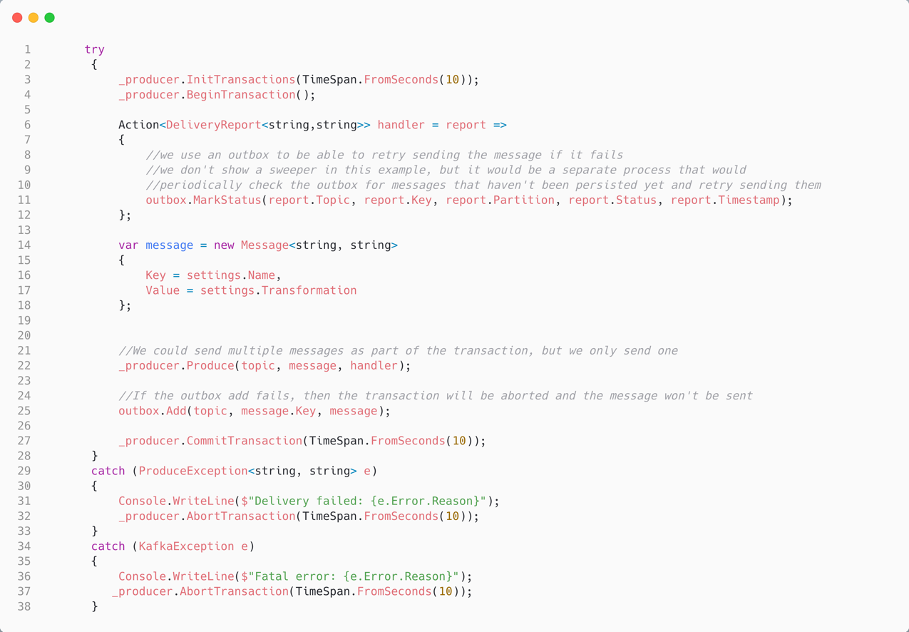
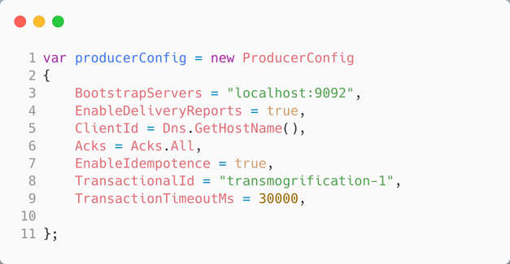
Exactly Once Producing a Message in C#
Mainly intended for a streaming app that does:
- consume
- process
- produce
Where it is important that we get one produce per offset committed from the stream we are reading
Idempotence requires Acks.All, sets MaxInFlight 5, MAX_INT retries
We can use a transaction with begin, commit/abort to ensure atomic-to-all partitions/only once production of a message to Kafka

Slide 48
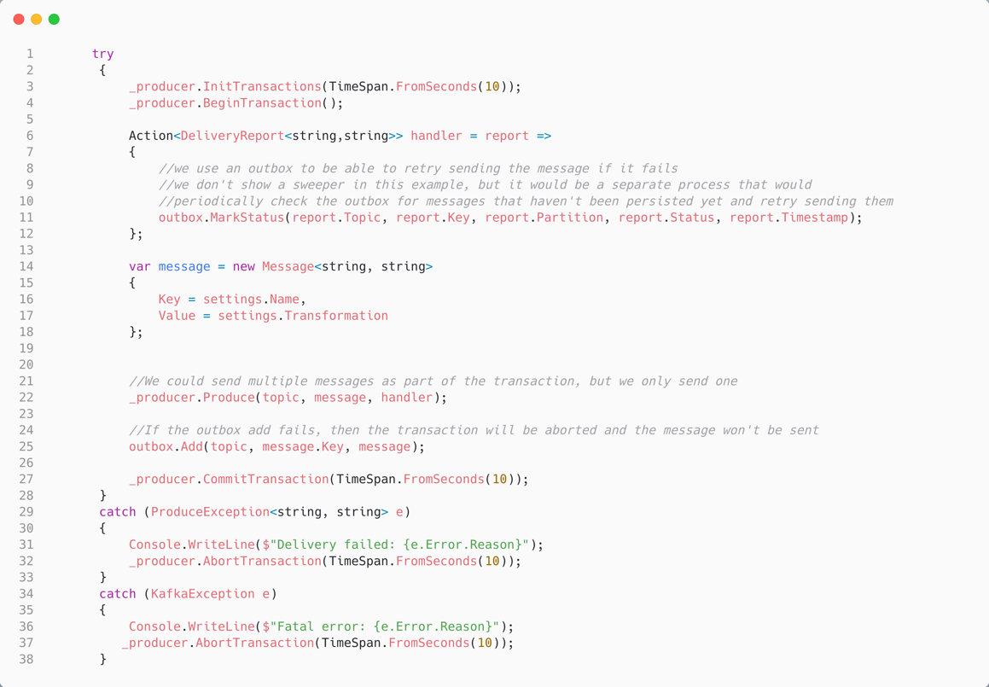
Demo Four: Produce a Message Exactly Once
Calvin and Hobbes – Bill Watterson

Slide 49
Reliable Consumers
40

Slide 50
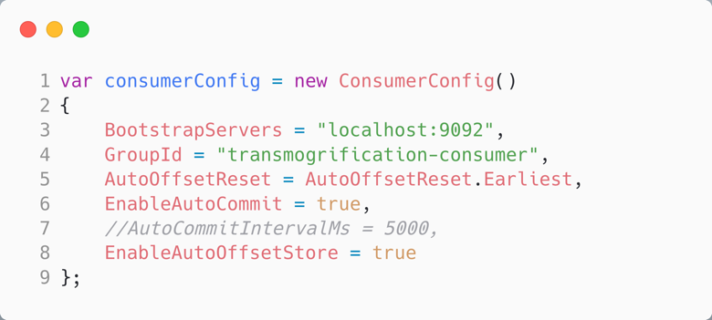
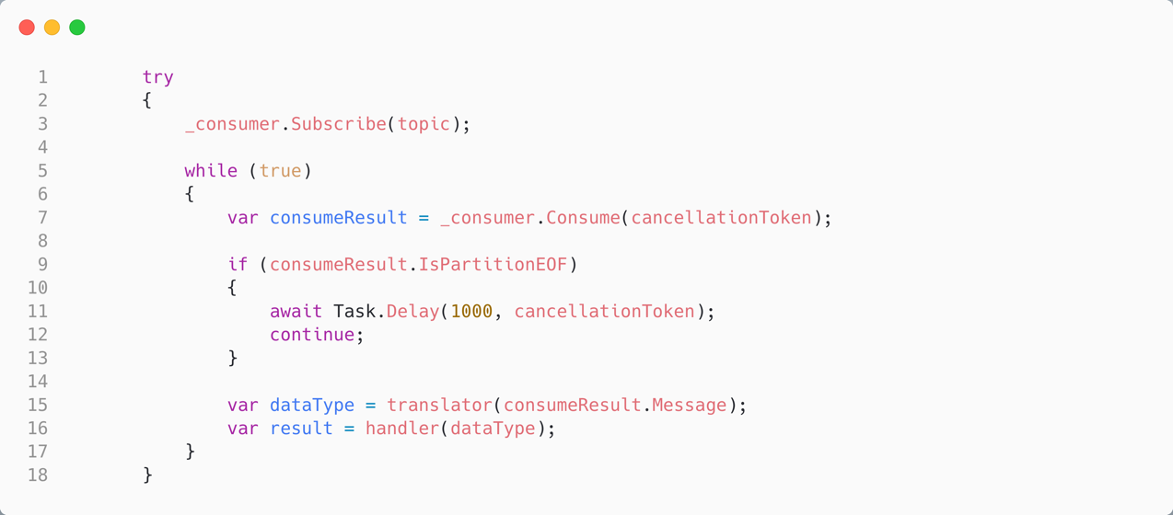
Auto Store and Commit Offsets in C#
Store the offset for a record we read, and commit it every 5s (by default)
If we fail to translate, or fail to handle the record, (including a crash) we will have committed the offset and will not re-attempt processing the record
Notes:
Automatic Commit
The easiest way to commit offsets is to allow the consumer to do it for you. If youi configure enable.auto.commit=true, then every five seconds the consumer will commit the largest offset your client received from poll(). The five-second interval
is the default and is controlled by setting auto.commit.interval.ms. Just like everything else in the consumer, the automatic commits are driven by the poll loop. Whenever you poll, the consumer checks if it is time to commit, and if it is, it will commit the offsets it returned in the last poll.

Slide 51
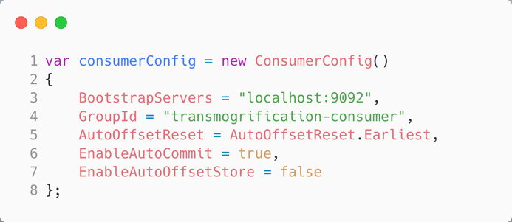
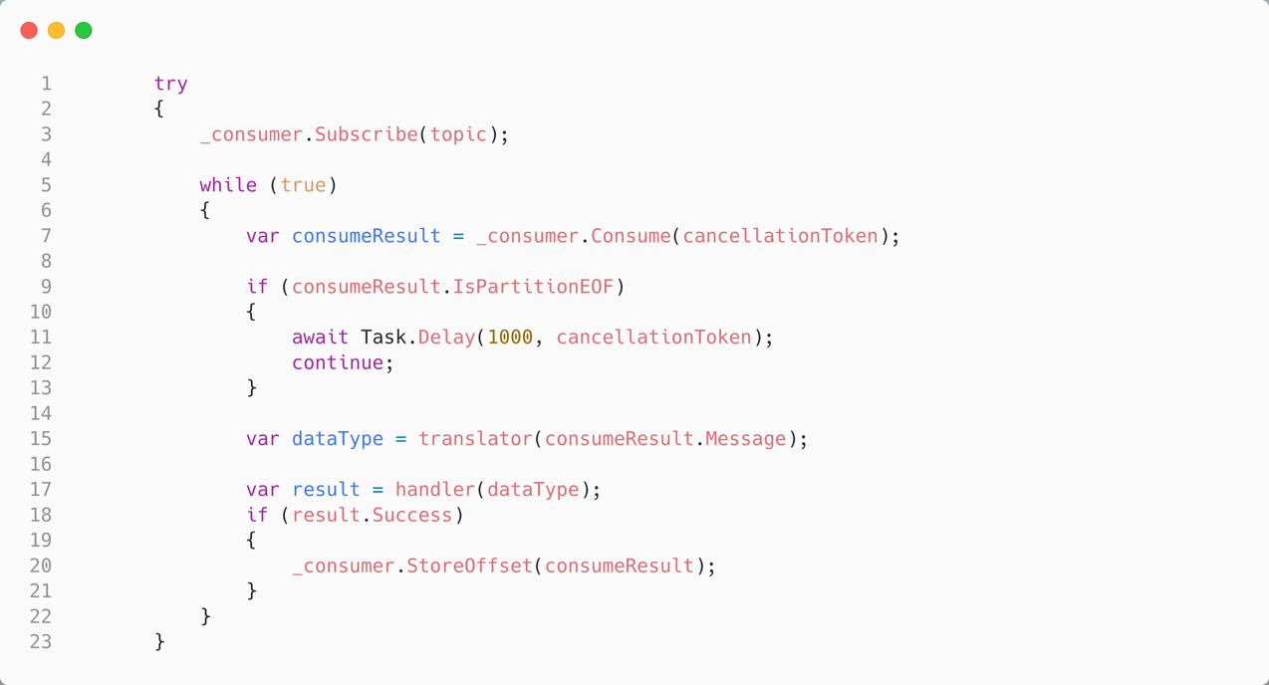
Auto Commit, Manually Store Offsets in C#
EnableAutoOffsetStore = false
Manually store offsets to the consumer’s cache; autocommit will write on a background thread
This means we only store processed records (every 5s)

Slide 52
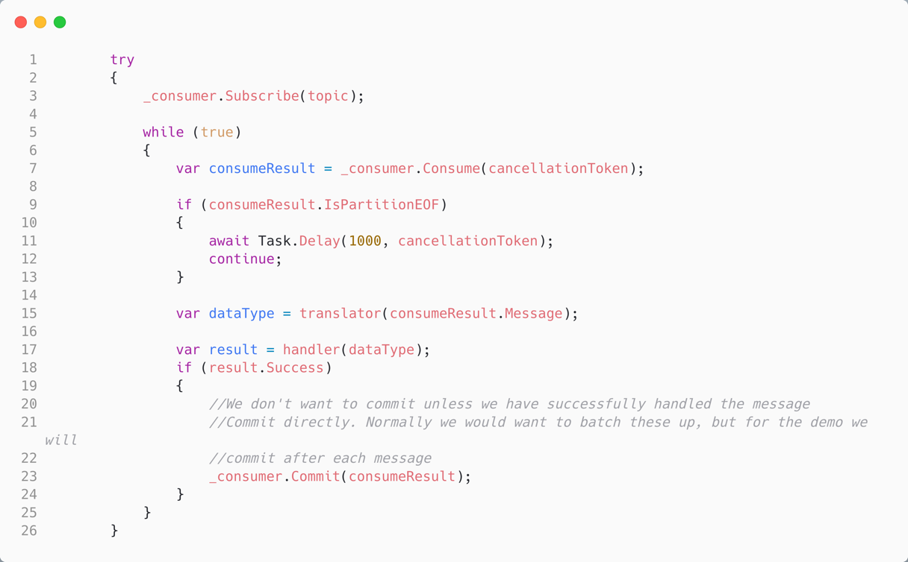

Manually Commit, Manually Store Offsets in C#
EnableAutoOffsetStore = false
EnableAutoCommit = false
We choose to manually store the commits
Manually store commits with:
_consumer.Commit(consumeResult)

Slide 53
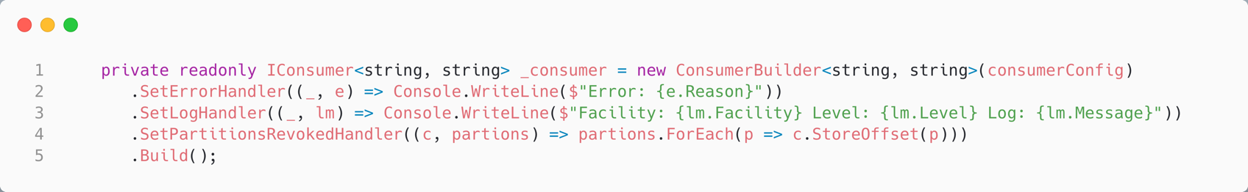
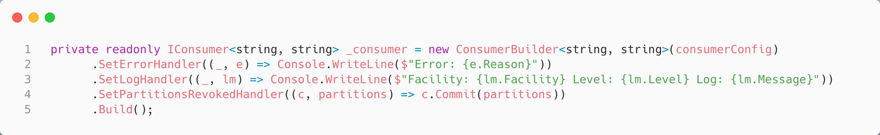
Partition Revoke and Offsets in C#
Our strategy when a partition is revoked (a new consumer joins the group) must match the strategy we use when we have that partition, and ensure outstanding offsets will be committed.

Slide 54

Demo Five: Reliably Consume A Message
Calvin and Hobbes – Bill Watterson

Slide 55
Offset Reset
48

Slide 56

Offset Reset in C#
AutoOffsetReset indicates what we should do if there is no offset for this GroupId in the _consumer_offsets topic.
Earliest – read from the earliest offset in the log
Latest – read any new messages appended to the log

Slide 57

Group Id and Offset Reset in C#
If you need to reset the offset to the beginning, so as to read the stream again, the easiest option is use a new GroupId.

Slide 58
Serializers, De-serializers & Schema Registry
50

Slide 59


Slide 60

Consumers using the new version can read messages with the last version
Producers using the new version can send messages to consumers with the last version
Producers and consumers may be on the last version and still communicate

Slide 61

Notes:
Worth noting, consider the value as bytes, even if you have serialized JSON

Slide 62

Producing with a Schema Registry in C#
We need to pass in a configuration for the
Schema registry
We use the Confluent Serdes Serializer that passes in the schema registry. It will register our schema if none exists.
Note that it uses NJSonSchema for markup and Newtonsoft for JSON serialization, under the hood
Notes:
Also worth noting that because when we use a non async Produce method, it will expect a sync value serializer and vice-versa.

Slide 63

Demo Six: Schema Registry in C#
Calvin and Hobbes – Bill Watterson

Slide 64
Brighter
58

Slide 65

Note this is not a Mediator pattern
Command Dispatcher

Slide 66

We can build a chain of handlers, to allow us to separate orthogonal concerns such as logging or resiliency from our application handling logic
Middleware

Slide 67

Brighter is about Requests
A Request is a message sent over a bus. A request may update state.
A Command is an instruction to execute some behaviour. An Event is a notification.
You use the Command Processor to separate the sender from the receiver, and to provide middleware functionality like a retry.
Darker is about Queries
A Query is a message executed via a bus that returns a Result. A query does not update state.
You use the Query Processor to separate the requester from the replier, and to provide middleware functionality like a retry.
Middleware
Both Brighter and Darker allow you to provide middleware that runs between a request or query being made and being handled. The middleware used by a handler is configured by attributes.

Slide 68

Commands and Queries
The Command Processor is for requests:
Send => Command, one target
Publish => Event, zero to many targets
We don’t return a value (strict CQS)
The Query Processor is for queries: ExecuteAsync has both a query type for the parameters and a result type for the response.
(We return a value, but don’t use to mutate (strict CQS)

Slide 69

Handling Commands
This is the Target Handler, where your domain logic lives. Attributes provide the Middleware Handlers. Here we add logging and Polly resilience policies.
We call the next handler in the chain. In principle you can just return from a target handler, because we use a Russian Doll model, so middleware can act “after” as well as before, but we do support middleware that is encapsulated by your target handler.

Slide 70

Handling Queries
This is the Target Handler, where your domain logic lives. Attributes provide the Middleware Handlers. Here we add logging and Polly resilience policies.

Slide 71
Using an External Bus
As well as using an Internal Bus, in Brighter you can use an External Bus - middleware such as RabbitMQ or Kafka - to send a request between processes. Brighter supports both sending a request, and provides a Dispatcher than can listen for requests on middleware and forward it to a handler.
Outbox
To ensure that a message is sent if you update your application’s state, we need a transaction that can span the update and the message that you want to send. Using an Outbox strategy we write both to the same database, and then transmit the message written to the table. We retry until we succeed.
Outbox Sweeper
To reduce latency we can immediately “clear the outbox”. But for guaranteed delivery we need to run a sweeper, in it’s own process, that will continually try to send unsent messages.

Slide 72

We will need two dependencies:
The Transaction/Connection provider, lets Brighter participate in your transaction when writing to its Outbox
Command Processor, lets us transmit a message via an external bus (i.e. a broker)
This is the lowest latency approach to transmitting, it should be supplemented by a sweeper for guaranteed delivery

Slide 73

The database ExecuteAsync and the CommandProcessor DepositPost share the same transaction.

Slide 74

Demo Seven: Brighter
Calvin and Hobbes – Bill Watterson

Slide 75
Diving Deeper
58

Slide 76
Links
The Sample Code: https://github.com/iancooper/KafkaForDotNetDevs
Brighter: https://github.com/BrighterCommand/Brighter
This Presentation: https://github.com/iancooper/Presentations
Other Topics
Kafka Connect: Turn a data source into a Kafka stream and vice versa
KSQL: Run queries on Kafka Streams
Streams Applications: Run queries on Kafka Streams in Code (C# Community Support only)
Alternatives to Connect: Flink, Benthos, etc

Slide 77
End

